Slide 1

NLP For Querying Database
Group# 28
Vishal Oswal
Harshil Shah
Ameya Hanamsagar
Rakesh Bora
Notes:
Group# 28

Slide 2

Project Goal
Processing natural language to interact with system to find restaurants
Full end to end dialogue system
Trade off with user preferences
NLP For Querying Database - Restaurant Finder - Group#28
Notes:
Group# 28

Slide 3

Project Domain
System searches for information in the restaurant domain
Attributes used for searching the restaurants
  Price
  Cuisine
  Location
  Service rating
NLP For Querying Database - Restaurant Finder - Group#28

Slide 4

Project Modules
Speech recognizer
Natural Language Understanding
Dialogue Management
Natural Language Generation
Speech Synthesizer
NLP For Querying Database - Restaurant Finder - Group#28

Slide 5

Natural Language Understanding
Approach 1 – Keyword based
Synonyms replaced with keywords
Rapid Automatic Keyword Extraction [RAKE] for keyword extraction
Searching criteria includes
  Cuisine
  Price
  Distance
NLP For Querying Database - Restaurant Finder - Group#28
Notes:
RAKE - Removes stop words and extracts the keywords
Group# 28

Slide 6
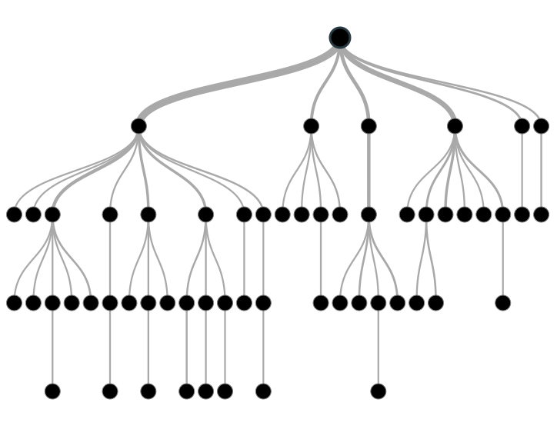
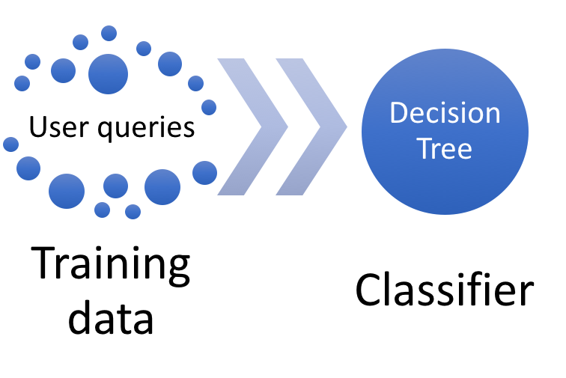
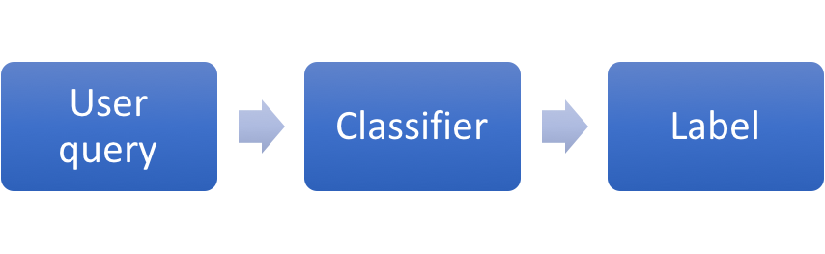
Natural Language Understanding
Approach 2 – Classification based
Training
Classification
NLP For Querying Database - Restaurant Finder - Group#28
Notes:
We used NLTK’s decision tree based classifier.
Training data had 120 sentences covering various patterns to mention either of 3 attributes.
Classifier trained with synonyms as well.
Decision tree based classifier produces an 80% accuracy.
The classification based approach recognizes only one attribute from the sentence based on the way it is trained.
Also tried naïve bayes classifier.
Group# 28

Slide 7







Dialogue management
Text
“Some fine dine places please”
Label
Dialogue act
Result
Natural language text
Query
Result
NLP For Querying Database - Restaurant Finder - Group#28
Notes:
Generation of dialogue acts
Requesting users to provide input
Querying the database once all attributes have been collected
Managing user interaction, NLU, NLG, speech recognizer and speech synthesis
Handling trade offs based on preferences & priorities
Group# 28

Slide 8

Natural Language Generation
Template based natural language generation
Generating speech text for
  requesting information
  confirming information
  informing user about searched and trade off results
NLP For Querying Database - Restaurant Finder - Group#28

Slide 9

Evaluation Plan
Whole system evaluation with two NLU approaches
  Keyword based approach
  Classification based approach
Feedback criteria
  Accuracy of system to understand the user search criteria
  Relevancy of results
  Perceived & actual task completion
NLP For Querying Database - Restaurant Finder - Group#28

Slide 10
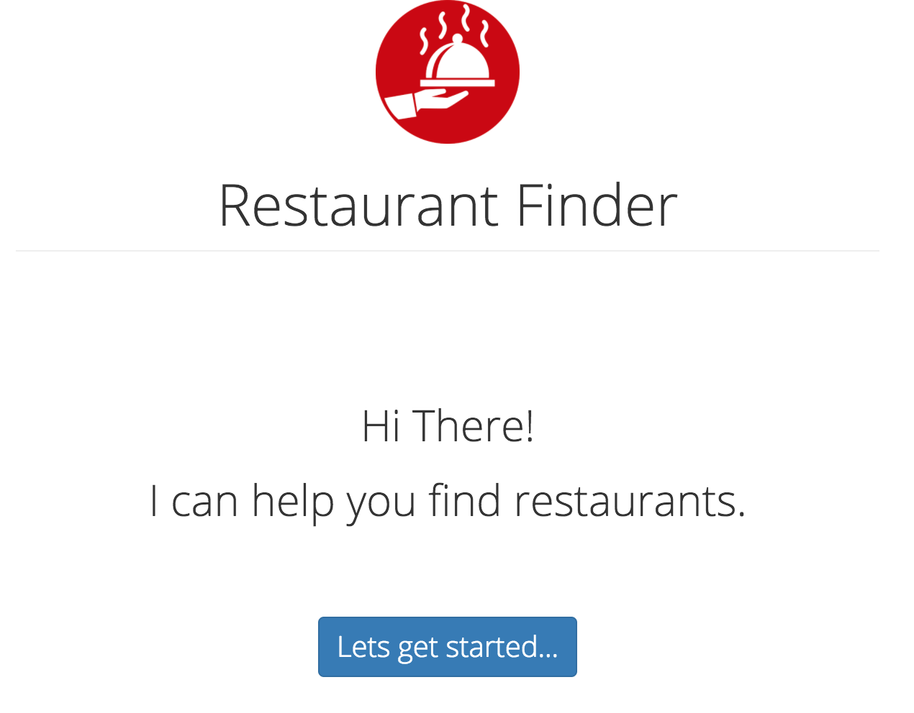
Flow of interaction
NLP For Querying Database - Restaurant Finder - Group#28

Slide 11
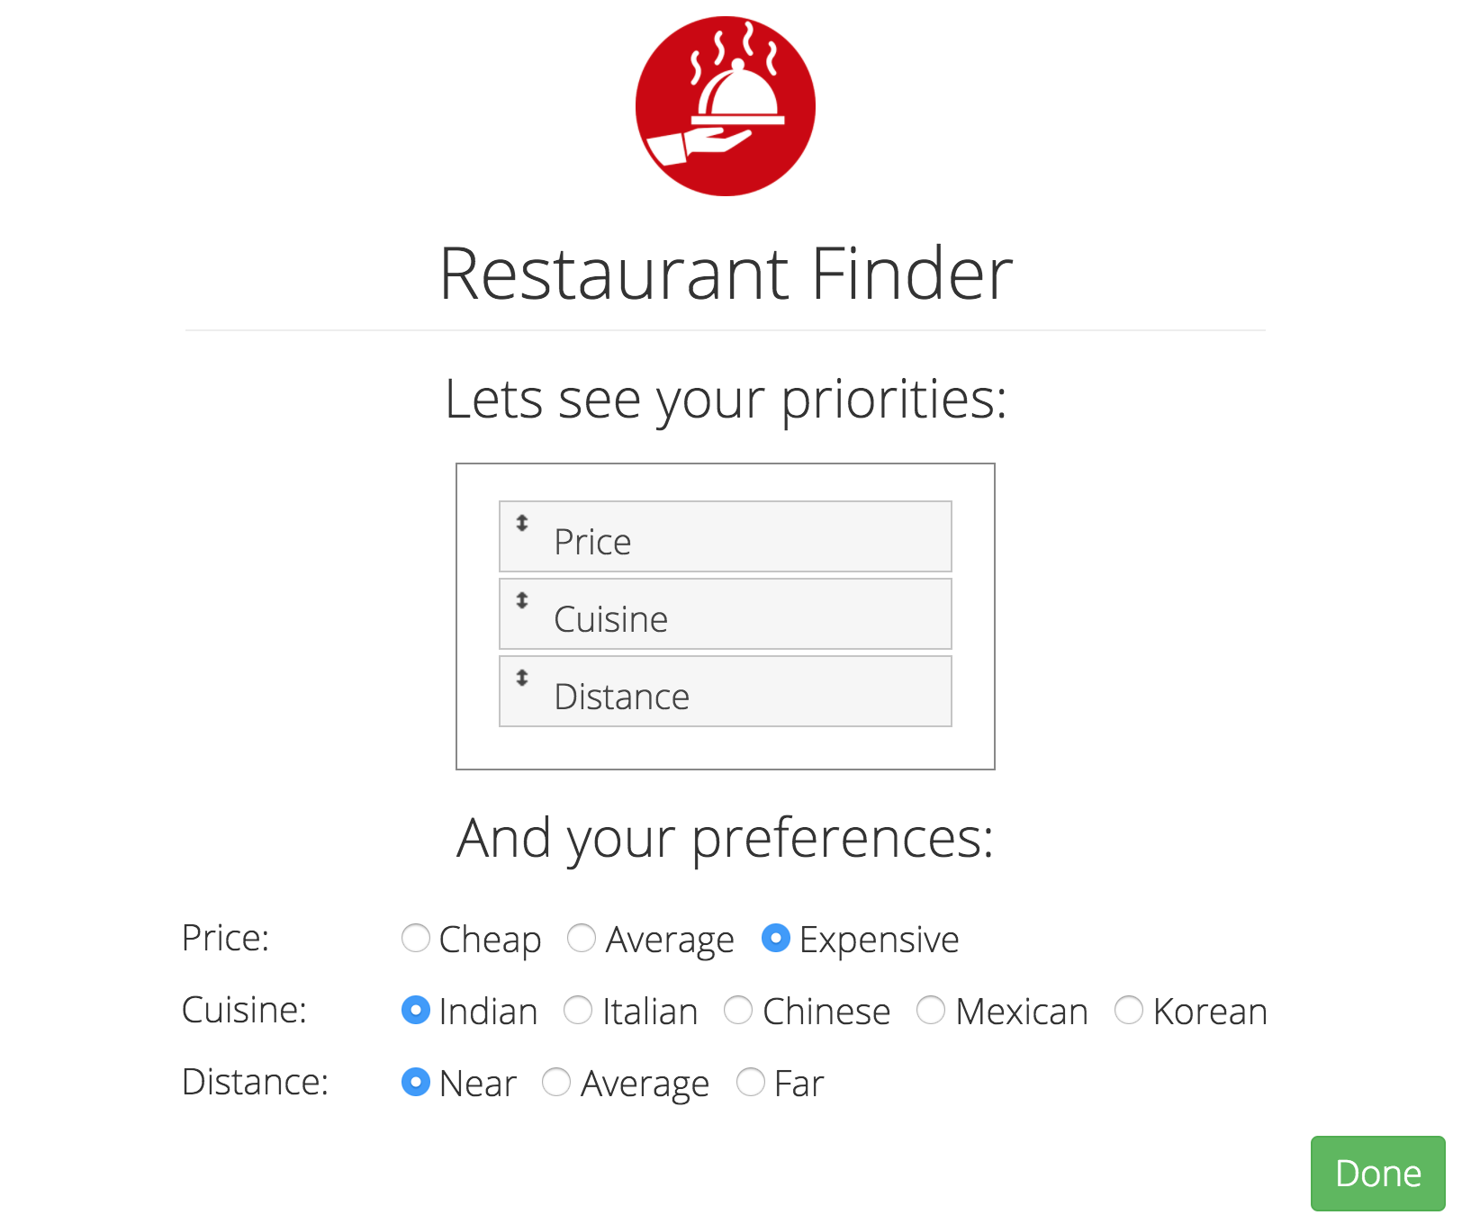
Flow of interaction
NLP For Querying Database - Restaurant Finder - Group#28

Slide 12

Flow of interaction
NLP For Querying Database - Restaurant Finder - Group#28

Slide 13
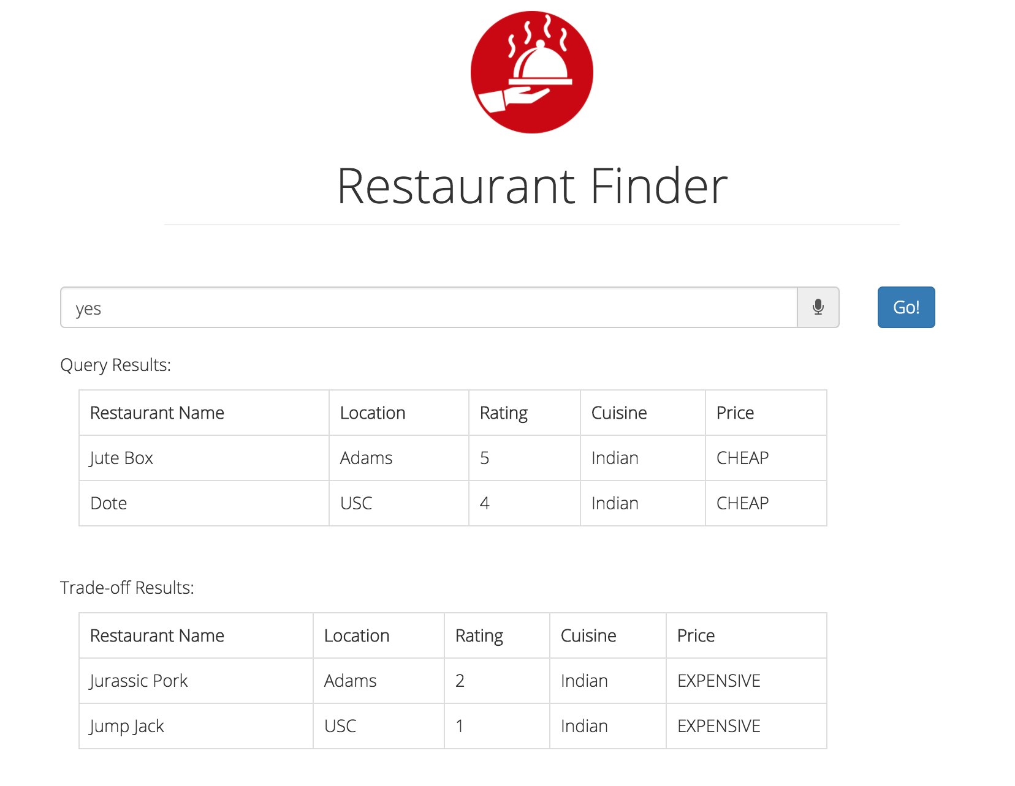
Flow of interaction
NLP For Querying Database - Restaurant Finder - Group#28

Slide 14
References
Paksima, Taghi, Kallirroi Georgila, and Johanna D. Moore. "Evaluating the effectiveness of information presentation in a full end-to-end dialogue system." Proceedings of the SIGDIAL 2009 Conference: The 10th Annual Meeting of the Special Interest Group on Discourse and Dialogue. Association for Computational Linguistics, 2009 - http://people.ict.usc.edu/~kgeorgila/publications/paksima_sigdial09.pdf
RAKE - https://github.com/fabianvf/python-rake
Classification based NLU - http://www.nltk.org/book/ch06.html
Speech Recognizer and synthesizer - https://developers.google.com/web/updates/2013/01/Voice-Driven-Web-Apps-Introduction-to-the-Web-Speech-API
NLP For Querying Database - Restaurant Finder - Group#28

Slide 15
Thank you !
Q/A?
NLP For Querying Database - Restaurant Finder - Group#28

